Slide 1
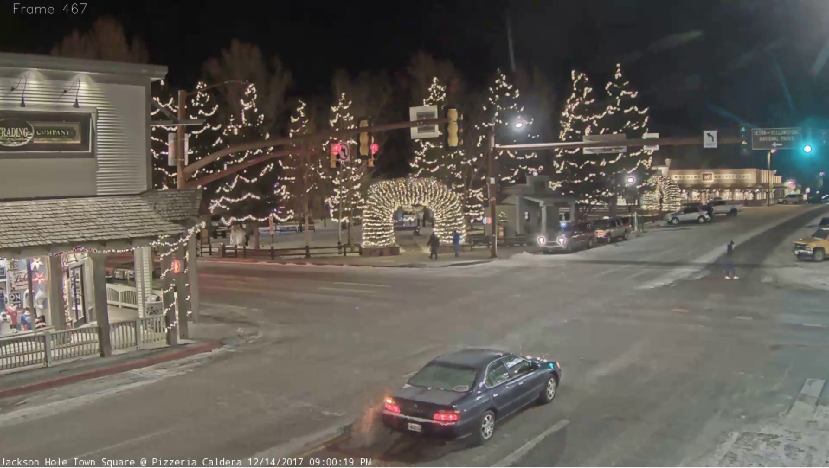
1
Convolutional
Autoencoder
2
Tube Production
Convolutional autoencoders encode regions of interest from video frames.
The encoded frames for each vehicle are linked together over time, producing an action tube.
Action tubes are used to programmatically generate heuristics for weak labeling of videos with the Reef framework.
The weak labels augment a CNN-based classifier that discriminates between two vehicle types.
3
Visual Weak Supervision
4
CNN Classifier

Slide 2
Weak Volume | lr = 1e-5 | lr = 1e-4 | lr = 1e-3 | lr = 1e-2
0 | 0.500 | 0.667 | 0.667 | 0.333
100 | 0.769 | 0.808 | 0.769 | 0.769
200 | 0.739 | 0.739 | 0.739 | 0.739
300 | 0.712 | 0.712 | 0.712 | 0.712
Weak Volume | lr = 1e-5 | lr = 1e-4 | lr = 1e-3 | lr = 1e-2
0 | 0.3 | 0.357 | 0.557 | 0
100 | 0.557 | 0.528 | 0.557 | 0.557
200 | 0.557 | 0.557 | 0.557 | 0.557
300 | 0.557 | 0.557 | 0.557 | 0.557

